Slide 1
Reinforcement Learning
The first steps… with Q-learning!

Slide 2
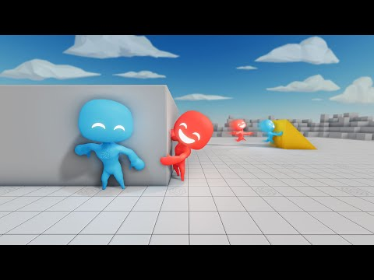

Slide 3
Reinforcement learning allows an agent to learn how to behave in an environment.

Slide 4
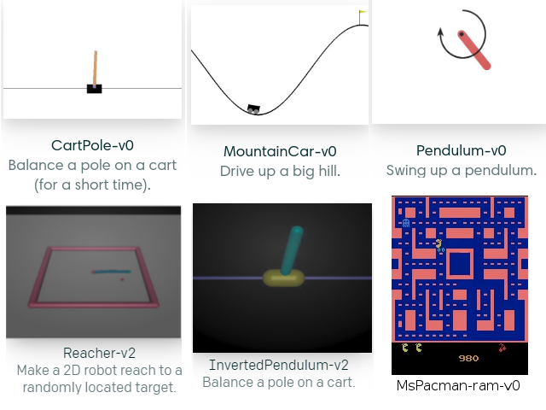
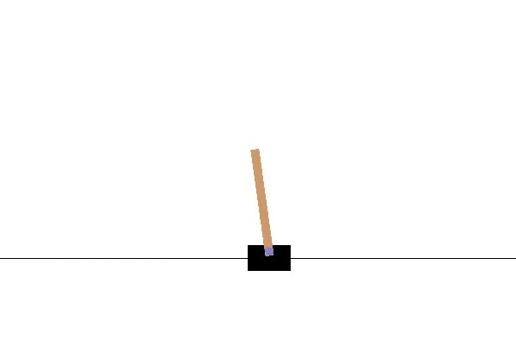
OpenAI Gym
An open-source set of environments for reinforcement learning
CartPole-v1

Slide 5


Slide 6

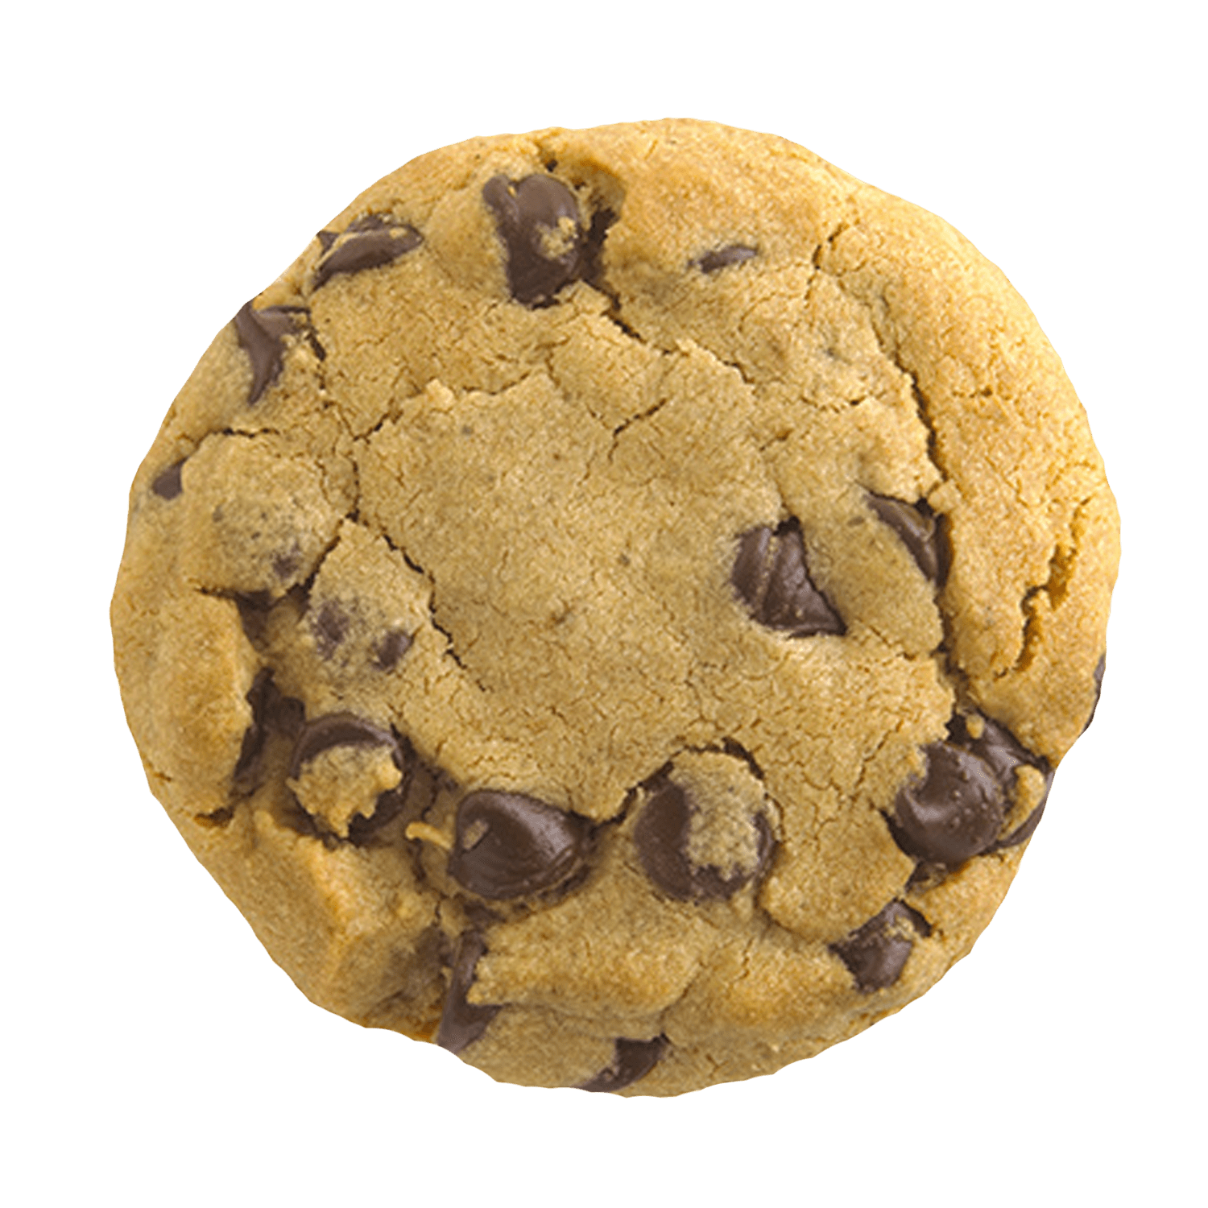
We give it rewards!
How does the agent know
how well it is doing?

Slide 7
Two Competing Goals
Exploration
Exploitation
Experiment and try new things! This is how you discover new strategies.
Apply what you’ve learned to do as well as possible.

Slide 8
Q-Learning

Slide 9
Q-Table
Actions
States
 | LEANING → | LEANING ←
DRIVE RIGHT →
← DRIVE LEFT

Slide 10
Q-Table
Actions
States
 | LEANING → TURNING ↻ | LEANING → TURNING ↺ | LEANING ← TURNING ↻ | LEANING ← TURNING ↺
DRIVE RIGHT →
← DRIVE LEFT

Slide 11
How do we create this table?

Slide 12
Q-Table
Actions
States
 | LEANING → TURNING ↻ | LEANING → TURNING ↺ | LEANING ← TURNING ↻ | LEANING ← TURNING ↺
DRIVE RIGHT →
← DRIVE LEFT

Slide 13
Q-Table
Actions
States
 | LEANING → TURNING ↻ | LEANING → TURNING ↺ | LEANING ← TURNING ↻ | LEANING ← TURNING ↺
DRIVE RIGHT →
← DRIVE LEFT

Slide 14
Q-Table
Actions
States
 | LEANING → TURNING ↻ | LEANING → TURNING ↺ | LEANING ← TURNING ↻ | LEANING ← TURNING ↺
DRIVE RIGHT →
← DRIVE LEFT
Choose a random action

Slide 15
Q-Table
Actions
States
 | LEANING → TURNING ↻ | LEANING → TURNING ↺ | LEANING ← TURNING ↻ | LEANING ← TURNING ↺
DRIVE RIGHT →
← DRIVE LEFT
See where it sends you

Slide 16
Q-Table
Actions
States
 | LEANING → TURNING ↻ | LEANING → TURNING ↺ | LEANING ← TURNING ↻ | LEANING ← TURNING ↺
DRIVE RIGHT →
← DRIVE LEFT
Learn from your reward

Slide 17
Q-Table
Actions
States
 | LEANING → TURNING ↻ | LEANING → TURNING ↺ | LEANING ← TURNING ↻ | LEANING ← TURNING ↺
DRIVE RIGHT →
← DRIVE LEFT

Slide 18
Q-Table
Actions
States
 | LEANING → TURNING ↻ | LEANING → TURNING ↺ | LEANING ← TURNING ↻ | LEANING ← TURNING ↺
DRIVE RIGHT →
← DRIVE LEFT
Choose a random action

Slide 19
Q-Table
Actions
States
 | LEANING → TURNING ↻ | LEANING → TURNING ↺ | LEANING ← TURNING ↻ | LEANING ← TURNING ↺
DRIVE RIGHT →
← DRIVE LEFT
See where it sends you

Slide 20
Q-Table
Actions
States
 | LEANING → TURNING ↻ | LEANING → TURNING ↺ | LEANING ← TURNING ↻ | LEANING ← TURNING ↺
DRIVE RIGHT →
← DRIVE LEFT
Learn from your reward

Slide 21
Q-Table
Actions
States
 | LEANING → TURNING ↻ | LEANING → TURNING ↺ | LEANING ← TURNING ↻ | LEANING ← TURNING ↺
DRIVE RIGHT →
← DRIVE LEFT

Slide 22
Q-Table
Actions
States
 | LEANING → TURNING ↻ | LEANING → TURNING ↺ | LEANING ← TURNING ↻ | LEANING ← TURNING ↺
DRIVE RIGHT →
← DRIVE LEFT
Choose a random action

Slide 23
Q-Table
Actions
States
 | LEANING → TURNING ↻ | LEANING → TURNING ↺ | LEANING ← TURNING ↻ | LEANING ← TURNING ↺
DRIVE RIGHT →
← DRIVE LEFT
See where it sends you

Slide 24
Q-Table
Actions
States
 | LEANING → TURNING ↻ | LEANING → TURNING ↺ | LEANING ← TURNING ↻ | LEANING ← TURNING ↺
DRIVE RIGHT →
← DRIVE LEFT
Learn from your reward

Slide 25
Q-Table
Actions
States
 | LEANING → TURNING ↻ | LEANING → TURNING ↺ | LEANING ← TURNING ↻ | LEANING ← TURNING ↺
DRIVE RIGHT →
← DRIVE LEFT

Slide 26
Q-Table
Actions
States
 | LEANING → TURNING ↻ | LEANING → TURNING ↺ | LEANING ← TURNING ↻ | LEANING ← TURNING ↺
DRIVE RIGHT →
← DRIVE LEFT
Start over from a random state

Slide 27
Q-Table
Actions
States
 | LEANING → TURNING ↻ | LEANING → TURNING ↺ | LEANING ← TURNING ↻ | LEANING ← TURNING ↺
DRIVE RIGHT →
← DRIVE LEFT
Choose a random action

Slide 28
Q-Table
Actions
States
 | LEANING → TURNING ↻ | LEANING → TURNING ↺ | LEANING ← TURNING ↻ | LEANING ← TURNING ↺
DRIVE RIGHT →
← DRIVE LEFT
See where it sends you

Slide 29
Q-Table
Actions
States
 | LEANING → TURNING ↻ | LEANING → TURNING ↺ | LEANING ← TURNING ↻ | LEANING ← TURNING ↺
DRIVE RIGHT →
← DRIVE LEFT
Learn from your reward…

Slide 30

Q-Table
Actions
States
 | LEANING → TURNING ↻ | LEANING → TURNING ↺ | LEANING ← TURNING ↻ | LEANING ← TURNING ↺
DRIVE RIGHT →
← DRIVE LEFT
…and learn from your new state

Slide 31
The Process
Start the simulation from a random state. Then…
Choose a random action
See where it sends you
Learn from the reward you get

Slide 32
The Process
Start the simulation from a random state. Then…
Choose a random action
See where it sends you
Learn from the reward you get …and the new state you end up in

Slide 33
The Process
Start the simulation from a random state. Then…
Choose a random action …or a good action (once you’re a little smarter)
See where it sends you
Learn from the reward you get …and the new state you end up in

Slide 34
The Process
Start the simulation from a random state. Then…
Choose a random action …or a good action (once you’re a little smarter)
See where it sends you
Learn from the reward you get …and the new state you end up in …learning more slowly over time

Slide 35
(I cheated a tiny bit…)

Slide 36
Q-Table
Actions
States
 | LEANING → TURNING ↻ | LEANING → TURNING ↺ | LEANING ← TURNING ↻ | LEANING ← TURNING ↺
DRIVE RIGHT →
← DRIVE LEFT

Slide 37
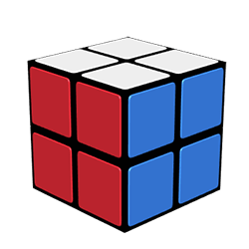
Leaning
Turning
Action

Slide 38
If this made sense, great!
But if not, don’t worry.

